Slide 1
Slack chat bot

Slide 2
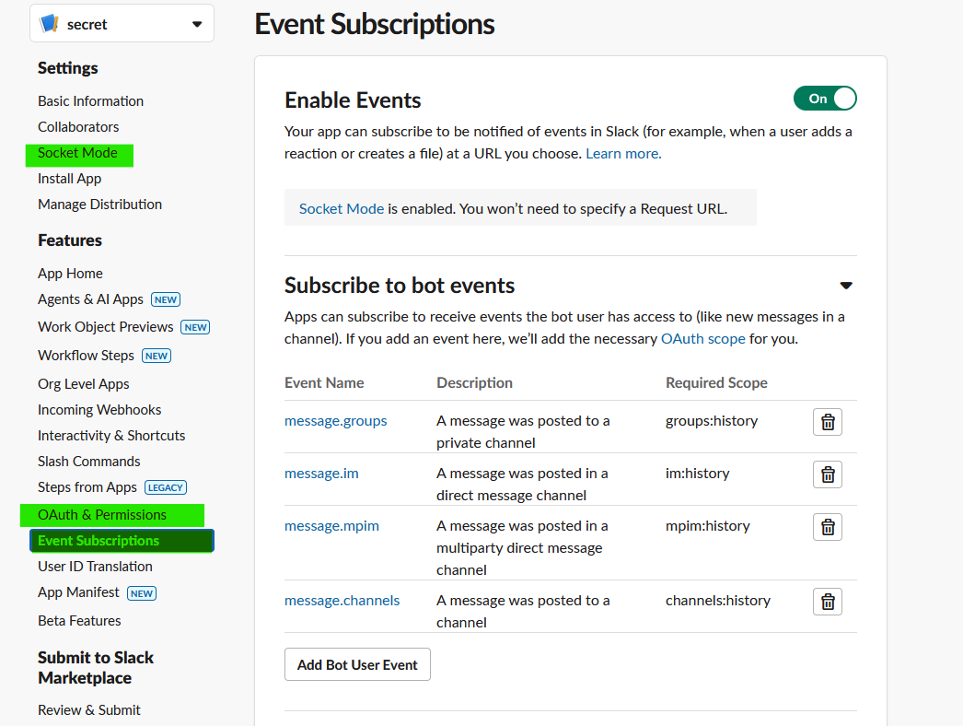
Create the Slack app
Go to api.slack.com/apps and create an app from scratch
In the left sidebar, click Socket Mode and "Enable Socket Mode’, generate your token, this would be the ‘APPTKN’ in python script.
In the left sidebar, click in OAuth & Permissions, go down and Bot Token Scopes and Add an OAuth Scope and add:
groups:history
im:history
mpim:history
In the left sidebar, click in Event Subscriptions enable them add Subscribe to bot events:
message.groups
message.im
message.mpim
message.channels
SAVE ALL CHANGES

Slide 3
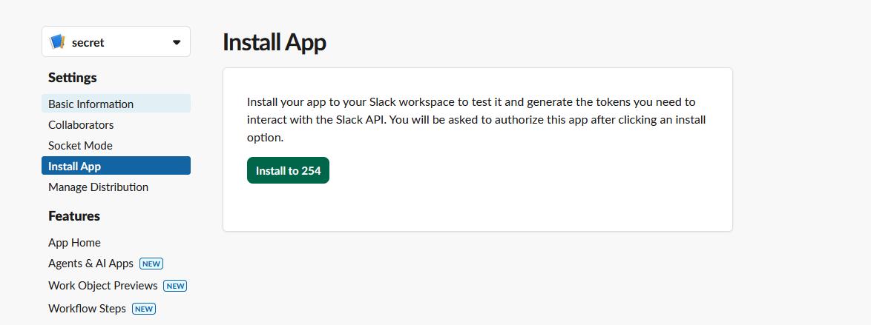
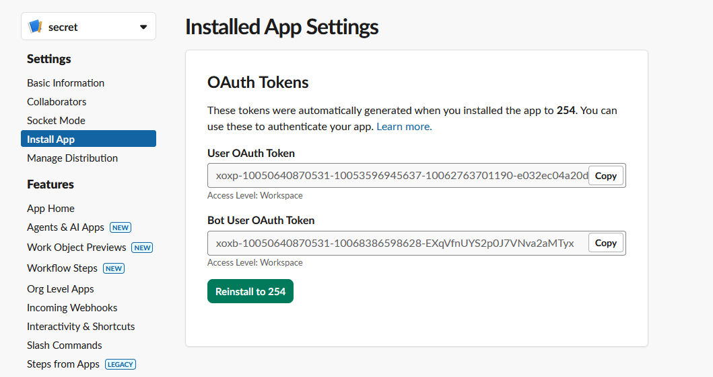
Install APP
This corresponds to “APPTKN” in the python file
This corresponds to “BOTTKN” in the python file

Slide 4
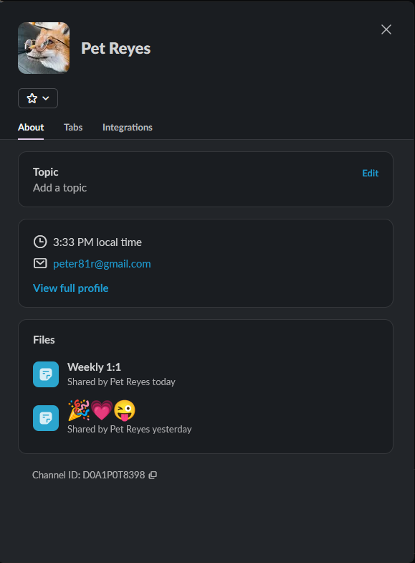
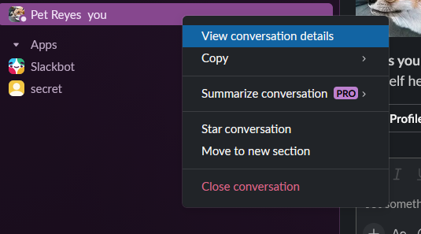
Getting the channel ID
Right click in the channel you want to get the ID from and click ‘conversation details’

